Slide 1
AirKitchen:
Week 10 Update
Team FoodXYZ
Mengdan Yuan, Wen Xin

Slide 2
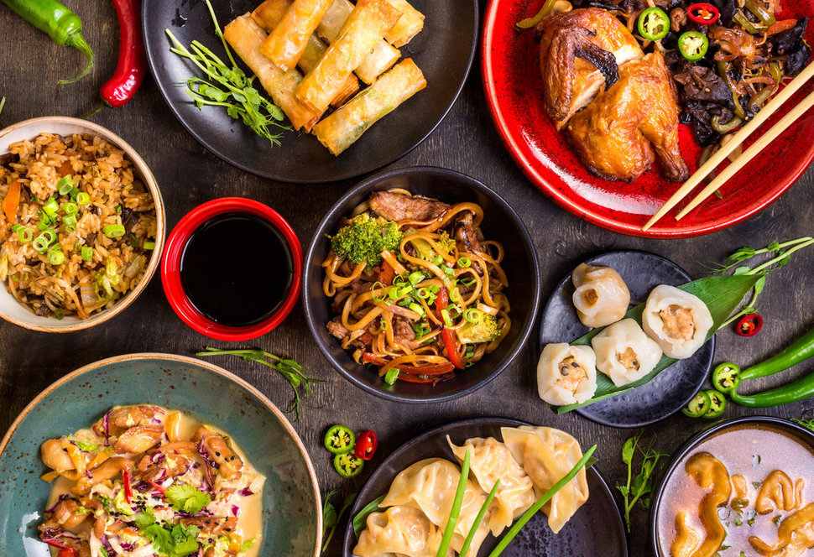
https://img.huffingtonpost.com/asset/585be1aa1600002400bdf2a6.jpeg?ops=scalefit_970_noupscale

Slide 3
More paper reading
Add Features:
user_comment/not
Kitchen features(like_num, price)
Feature Selection:
Use association rules to do feature selections
comparing rankings of features from different models（top 70）
Model:
Bootstrap training dataset
Stack

Slide 4
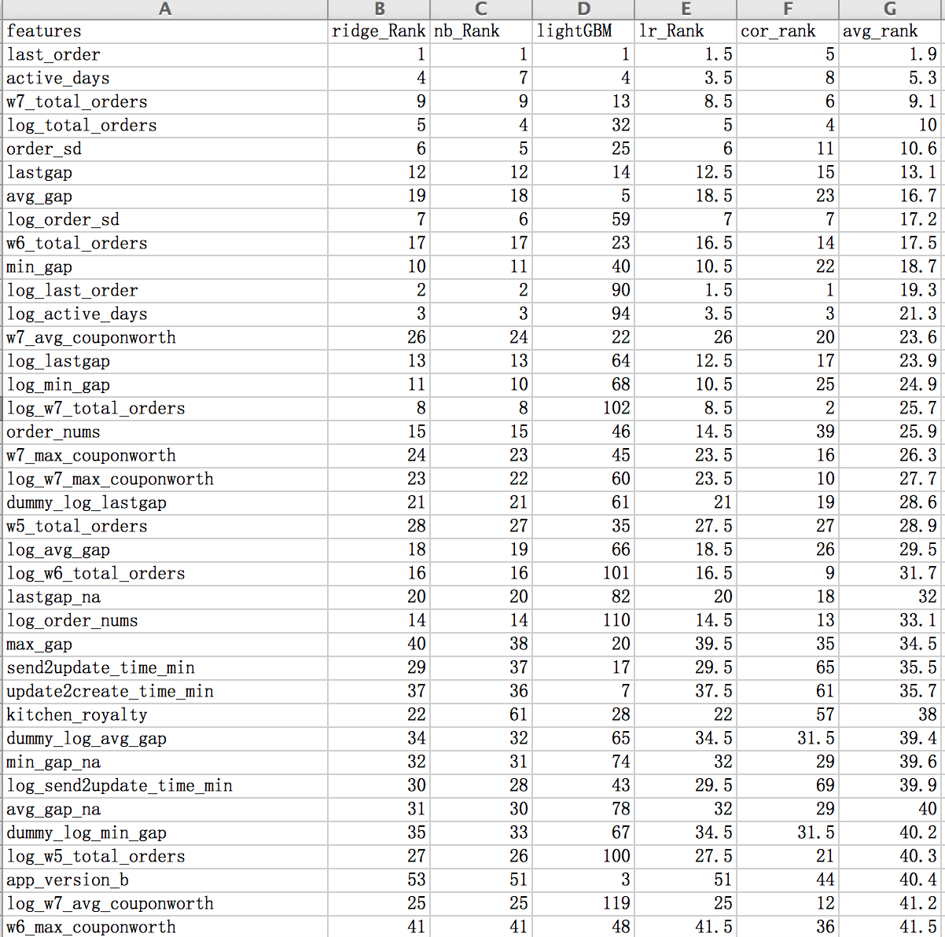
Feature Selection

Slide 5
Model
Model | Train | Test
Logistic Regression | 0.8815 | 0.8732
Ridge Classification | 0.8832 | 0.8714
Light GBM | 0.8932 | 0.8767
Random Forest | 0.8913 | 0.8754
Neural Network | 0.8813 | 0.8756
Stack

